Slide 1
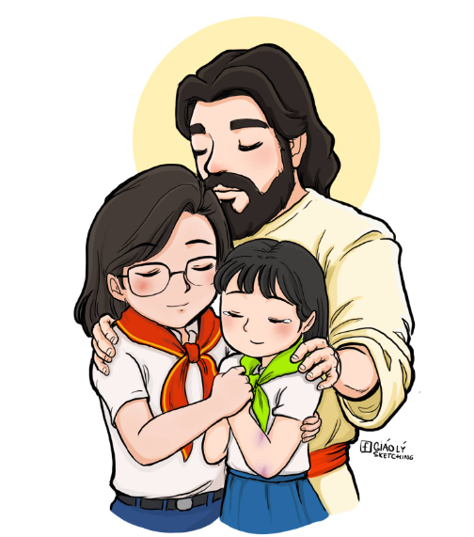
The Psychology and Social Development of Seedlings
Tâm Lý và Các Vấn Đề Ở Tuổi AN
Vươn Lên 38 – Cấp 2 AN
HLV Giuse Hà Văn Jimmy

Slide 2
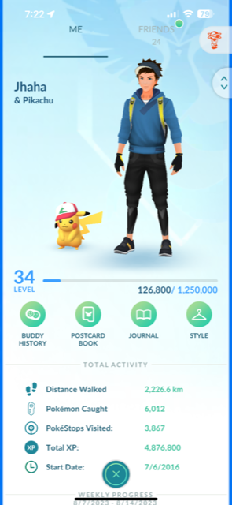
FOCUS!
COUNT THE PIKACHU!

Slide 3
Child Development
01
02
03
04
Physical
Cognition
Social and emotional development
Moral Development

Slide 4
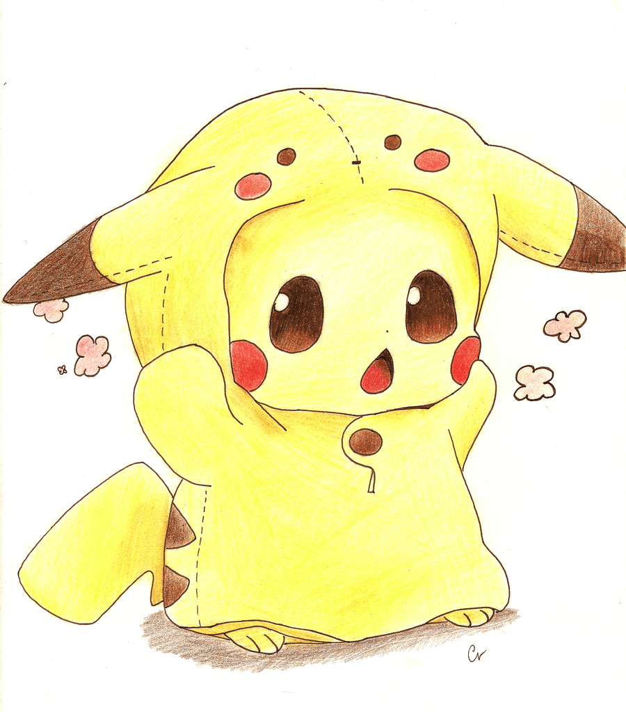
Characteristics
approach
PHYSICAL DEVELOPMENT
A lot of games
Lessons in games
Short lessons
Energetic
A lot of energy
Easily distracted (short attention span)
Still learning (new to life)

Slide 5
—Someone Famous, Probably
“keep it simple, stupid”

Slide 6
Cognitive and language
AU NHI IMPACT
approach
Keep in mind
Explain in simplest terms
Bored/easily distracted
Understanding is limited (based on life)
Use easy vocabulary
Light on lecture, heavy on fun
Visually appealing
Observe speech patterns and tendencies

Slide 7
Social and emotional
observant
Critical
IDEAS
Bonds
They see the smallest things we may miss.
Critical and self-conscious
A lot of ideas, good and bad.
Forming close friendships and peer groups

Slide 8
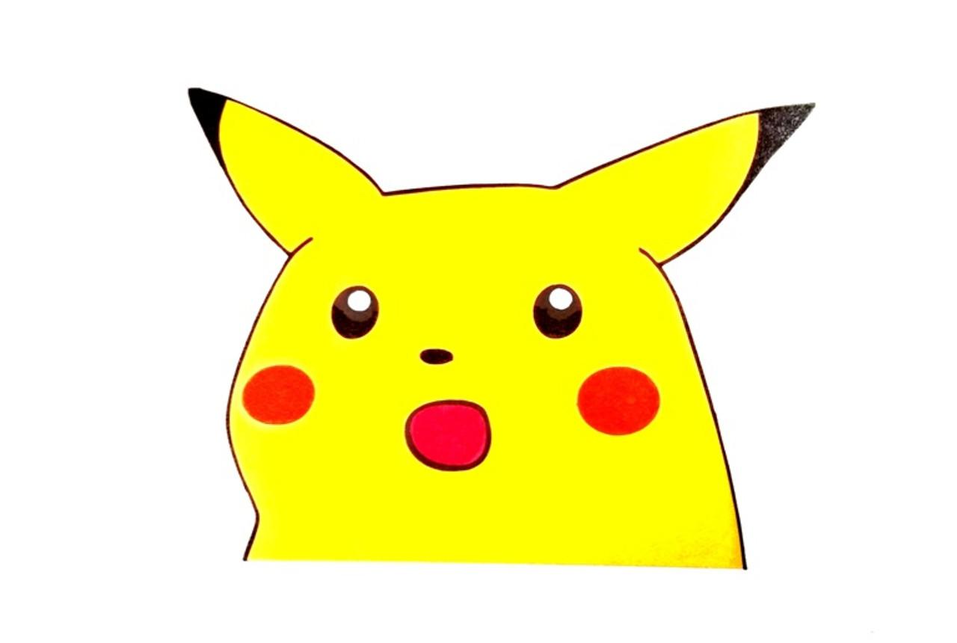
How to approach AN?
Reminders
observe
signs
Praises
Send constant reminders, as they are very carefree and forgetful.
How are they feeling? They learn best when happy!
Be sure to recognize accomplishments, no matter how big or small.
Aggression, shyness, tendencies.
Girls are passive aggressive, boys are physically aggressive

Slide 9
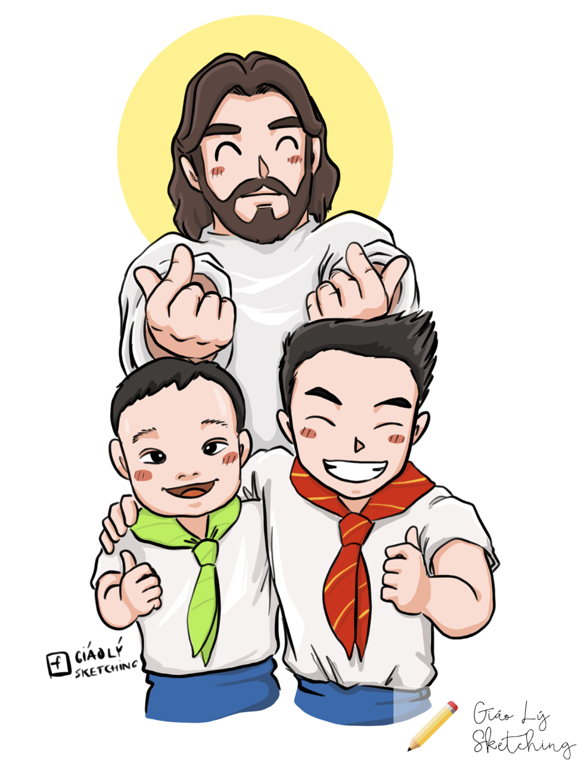
Spiritual Moral
Absorbs everything around them
Concrete thinkers
Developing a moral conscience
Be cognizant of what you say and do
Have a strong understanding of the Catholic Faith

Slide 10
Game Time

Slide 16
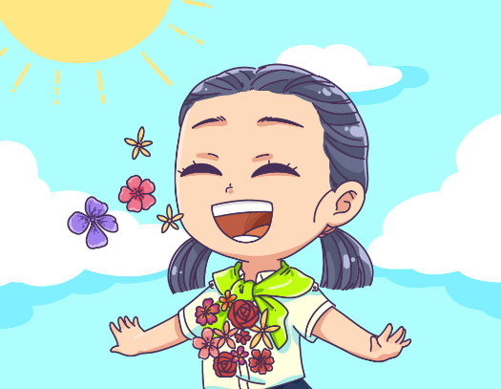
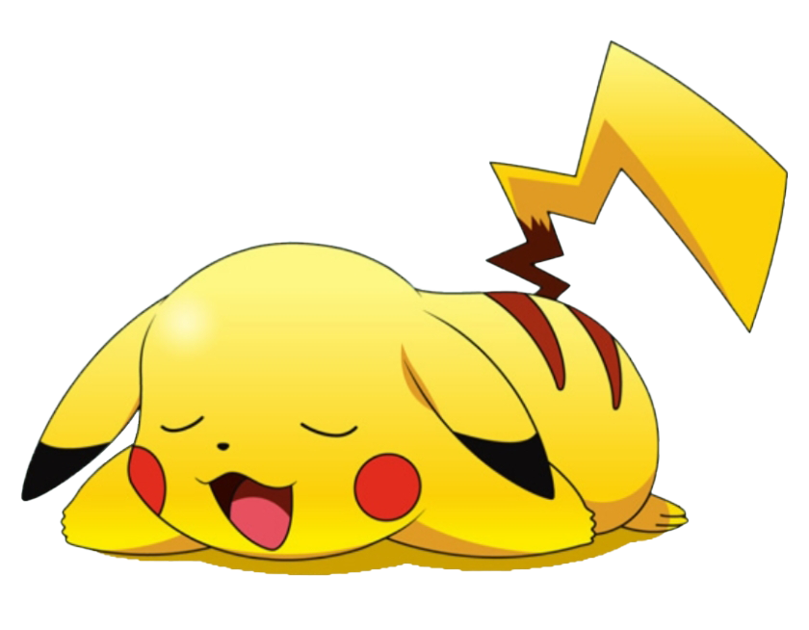
Special needs
Steps:
Observe: Notice their actions. The earlier it is addressed, the better.
Evaluate: What are their capabilities, what do they know?
Set up an Individualized Education Program (IEP): How to effectively deliver your lesson.
Monitor progress: how are they behaving to your direction?

Slide 17
So… How many were there?

Slide 18
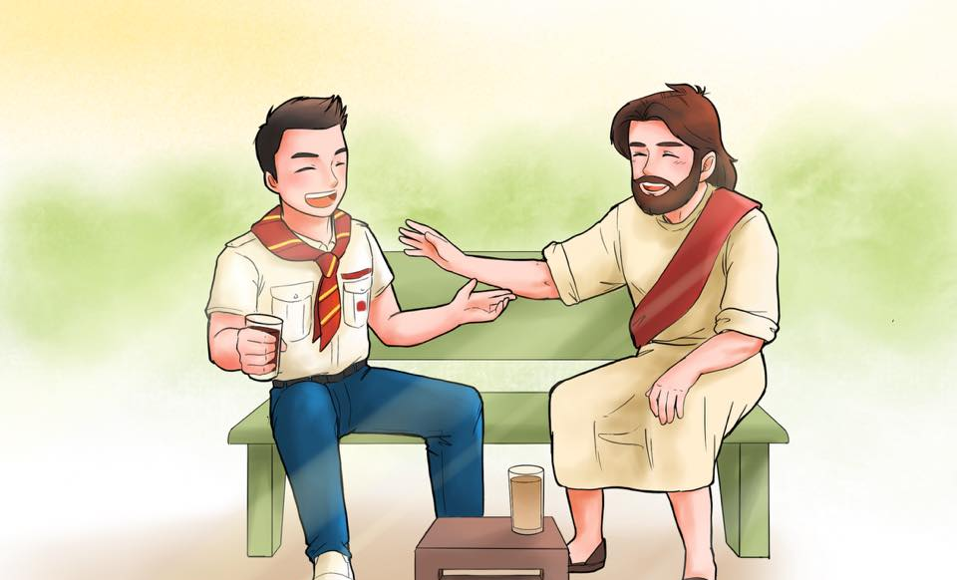
Contact me
Email: jimmy.v.ha@veym.net

